Slide 1
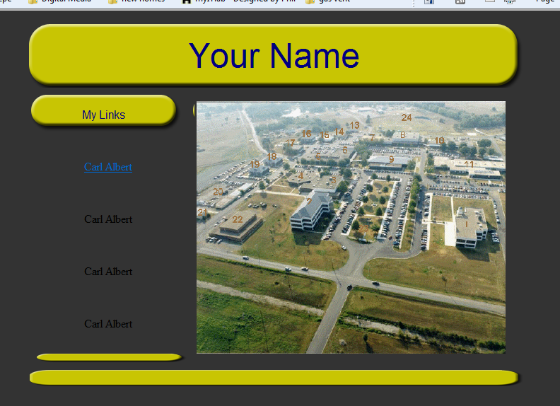
Page background = 333333

Slide 2
Table
centered
width =“712“
8 rows
2 columns
One cell with height=“95“
Center text
One cell
Center Text
width="229"
height="70"
height="20"
height=“30"
One cell

Slide 3
Image aerial.gif
Arial 36 navy
Image map
Link to Carlalbert.edu
Background big.png
Background small.png
Arial Navy
Link to carlalbert.edu
Image Smallthin.png
Image Bigthin.png

